Slide 1
Summer Internship

Slide 2
Project Overview
This is a simple project which is inspired by platforms such as Moodle,Edx.
This platform’s aim is to make students able to get information about the lesson they want to take and make instructors able to add new courses to system and get information about their students.

Slide 3
Technologies that are used for this project
Spring Boot
Spring mvc- mainly used technology for its mvc pros.
Postgres- used for database tables of the system
Hibernate- used for mappings between Postgres and spring boot
Thymeleaf- template engine
Spring Security-used for user roles
Spring Boot starter mail- used to send user’s id and comminications between instructors and students
HTML, JQuery, css (not much)

Slide 4
Difficulties
-Since i do not know javascript much, I could not use Rest api for this project since using a view controller for redirection and rest controller at the same time was not reasonable.
-Mapping many-to-many between lessons and students in database does not work as intended by the beginning
-log out support

Slide 5
Students and Their capabilities
Students are thought of to have limited access on platform, they cannot add lessons, cannot determine the grade of the lesson and cannot see the other students who takes the lessons with them so interface is as following

Slide 6
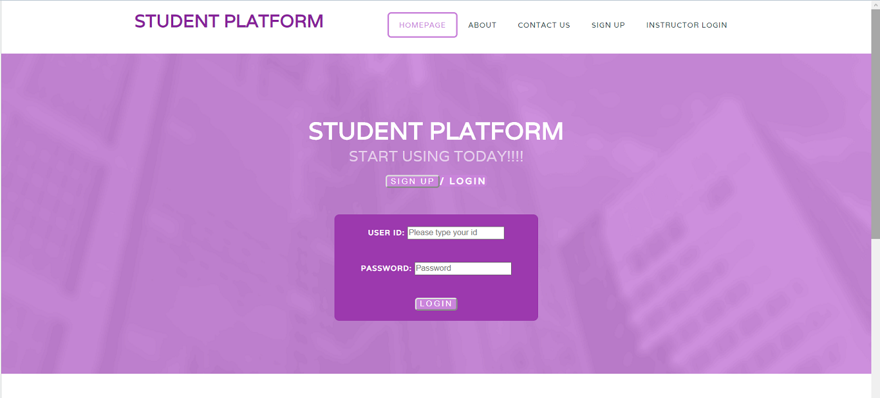
1)Homepage

Slide 7
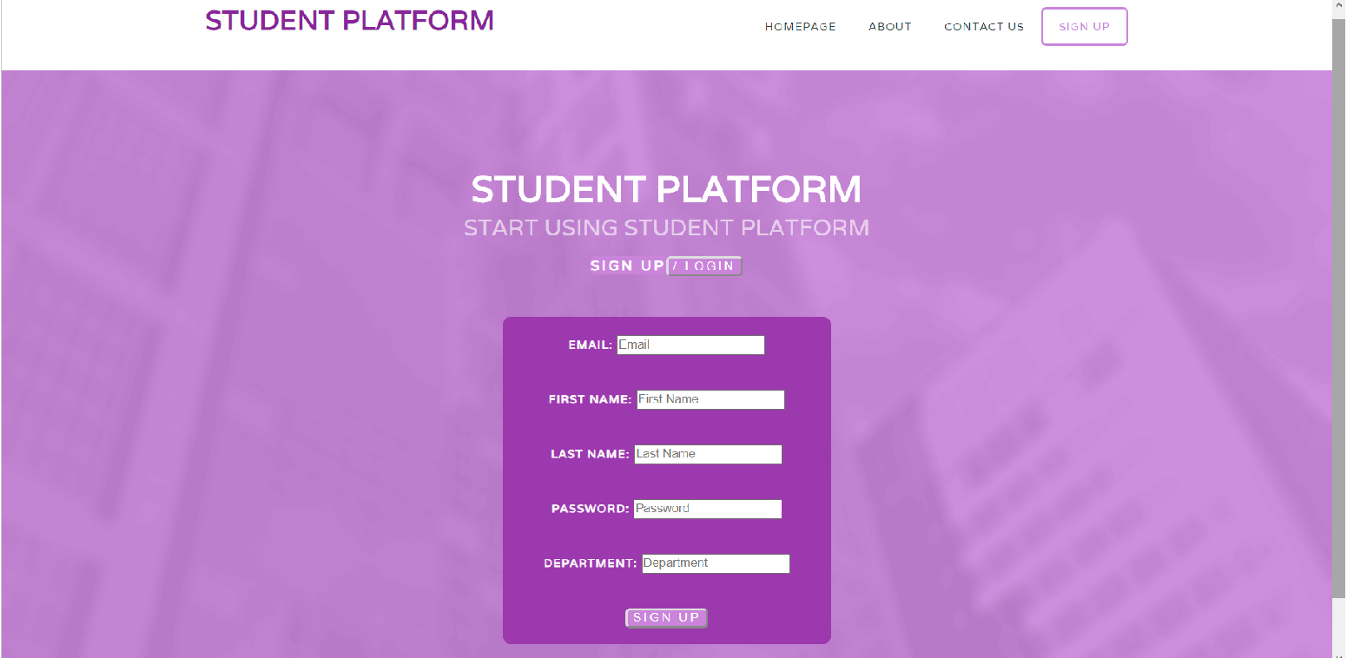
2)Sign up

Slide 8
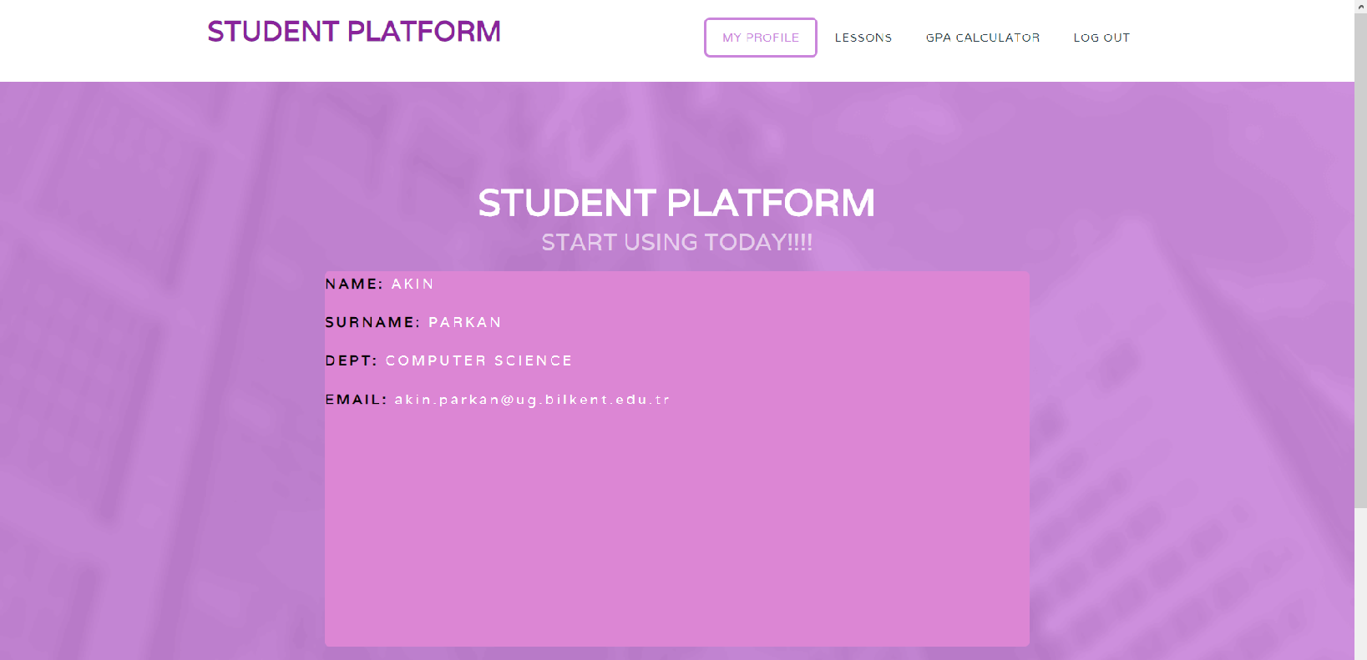
3)Student Profile

Slide 9
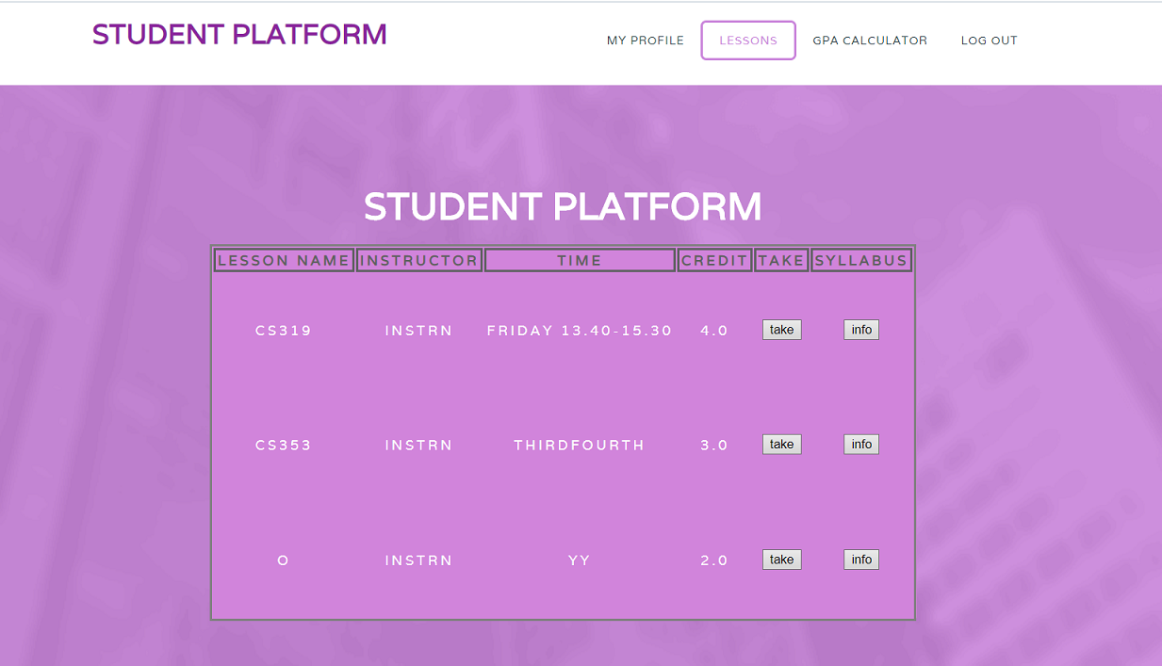
4)Lessons

Slide 10
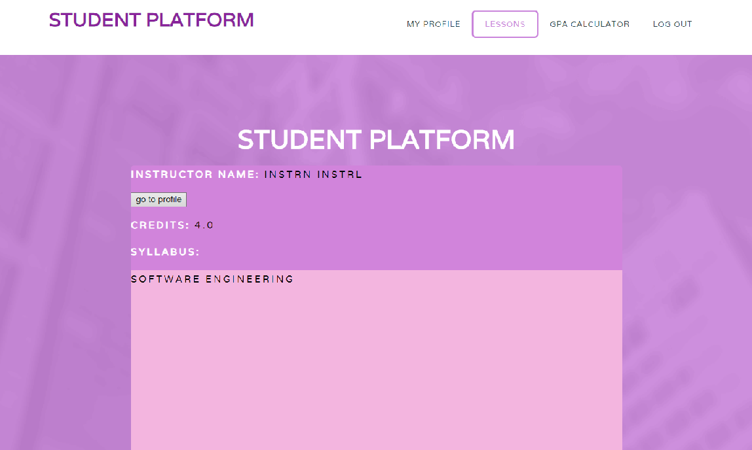
5)Lessons’ Info

Slide 11
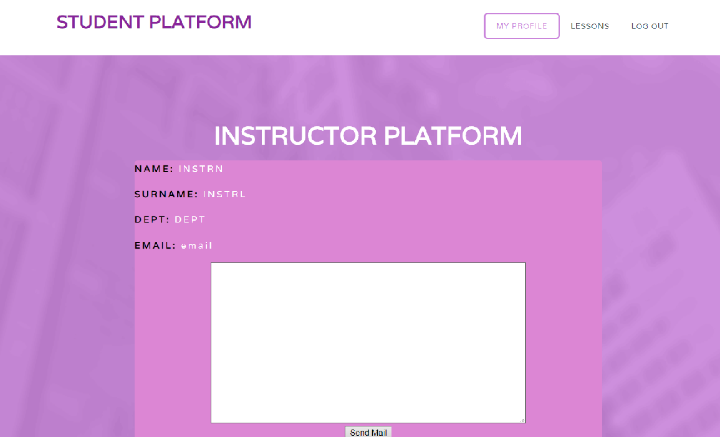
6)Instructor Info

Slide 12
Instructors and Their Capabilities
Instructors can add lessons to the system and determine gpa of the student addition to basic student accesses

Slide 13
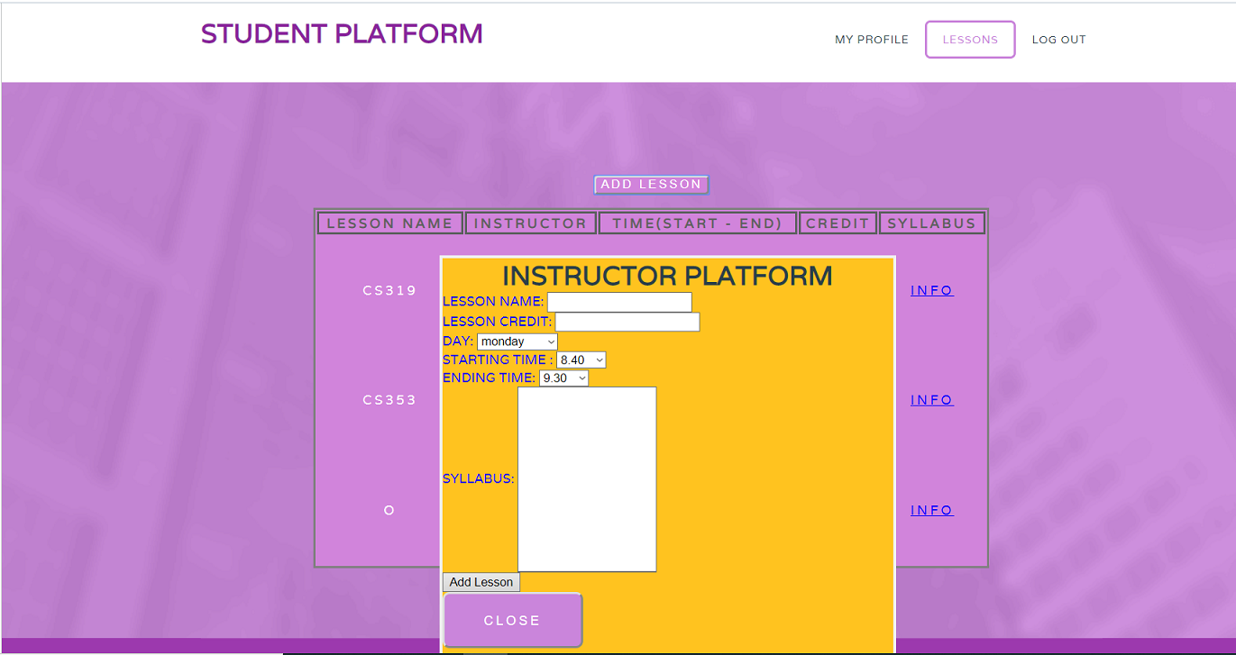
Add Lesson

